Slide 1
Meta models
Kri,
Garching, 15.12.2021

Slide 2
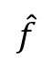

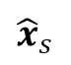

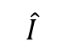
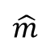
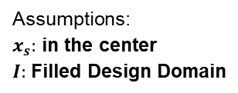
ADG for R1.1.3:
Quantities of Interest
Payload
Time taken
Tracking error
Weight
Stiffness
m
ts
ep
u
L- Length
r – Radius
x - Task description
ρ - Density
Τ_{max}- Max joint torque
τ - Input torque
P – Power
θd - Desired joint-space configuration
Kx - Control gains
θ - Joint angle
M, C, G – Dynamics coefficients
Rx – Eigen values
u - Displacement
ts – Settling/cycle time
ex – Tracking error
Cj – Joint compliance
σy - Yield strength
K – Link stiffness
Τf - Feasible torque
Intermediate
Variables
θ(t)
Assumptions:
$x_{s}:$ in the center
$I:$ Filled Design Domain
Multi-body simulation
Model
Task Attributes (Assumed)
C(θ)
xd
xi
x(t)
M(θ)
G(θ)
τf
θd
f
m
$$x_{s}$$
$I$
$$\hat{m}$$
$${\hat{x}}_{s}$$
$$\hat{f}$$
$$\hat{I}$$
Design Variables
Mechanical
Attributes
Kinematic
Attributes
Actuator
Attributes
Control
Attributes
K
L
Τ_{max}
Kp
Kd
Ω
LPL I 2021
2

Slide 3
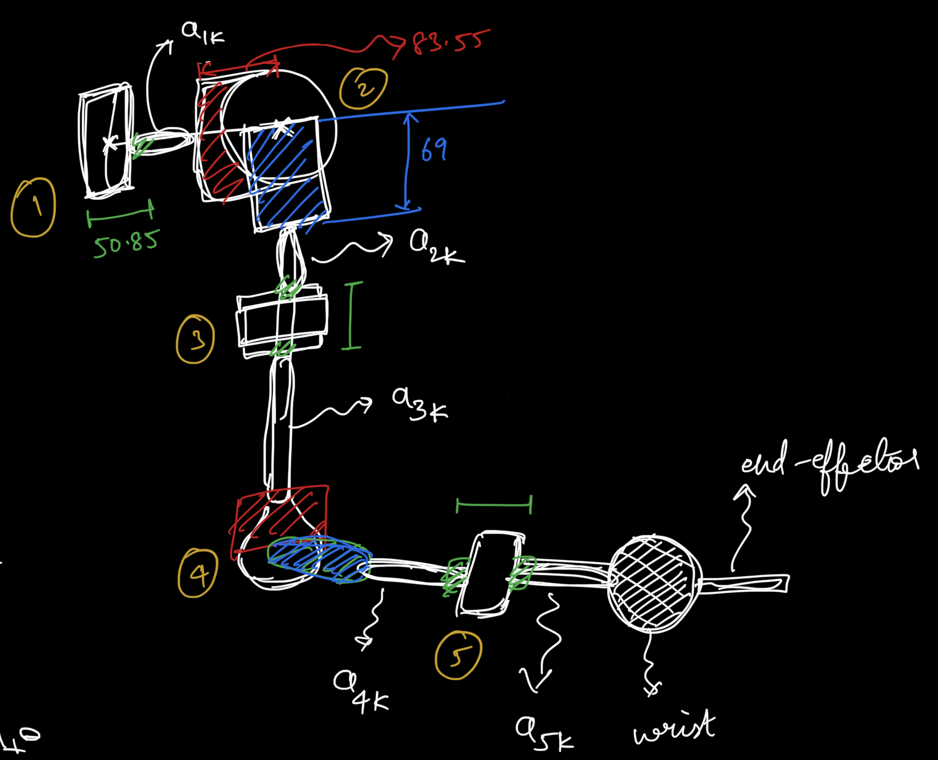
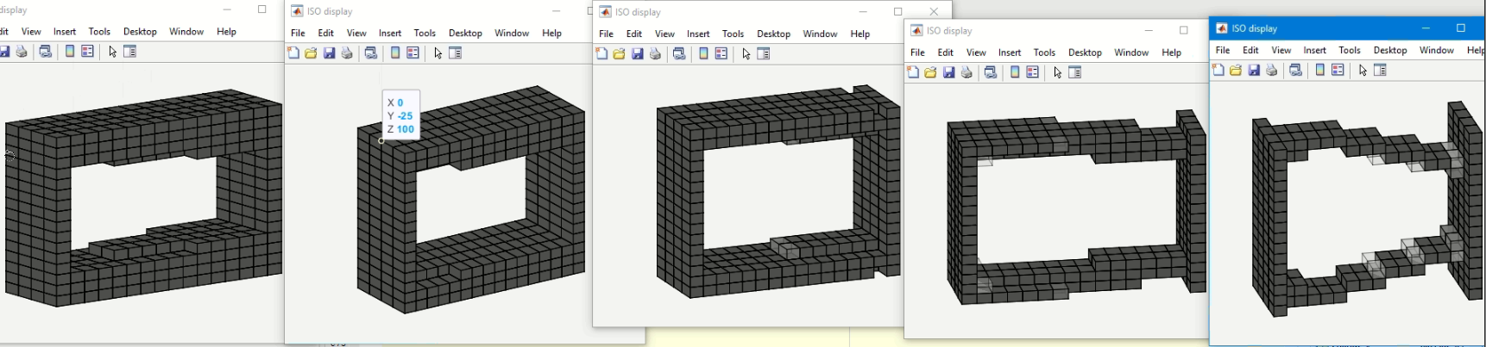
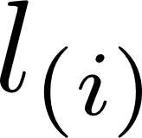
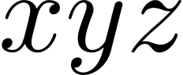
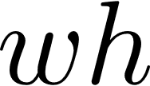
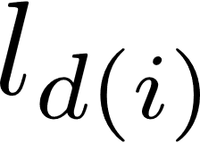
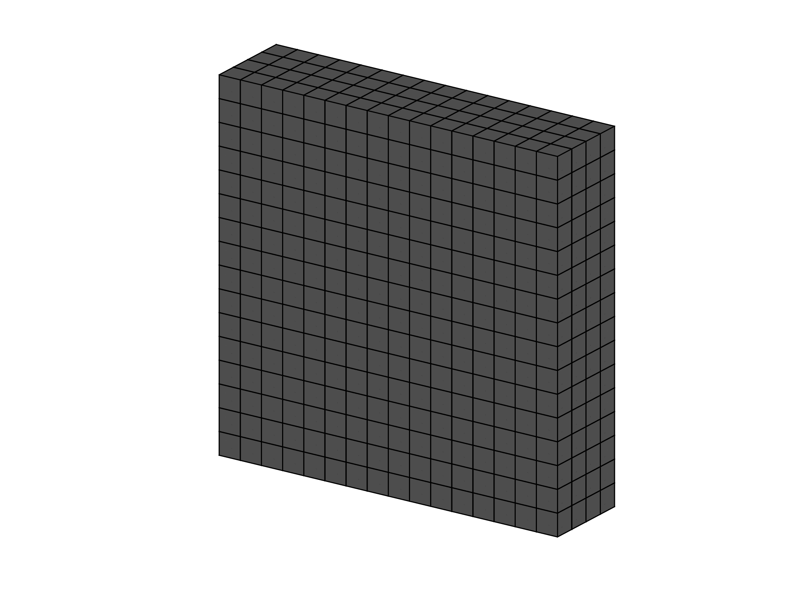
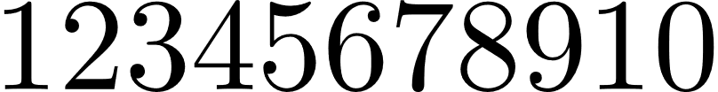
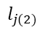
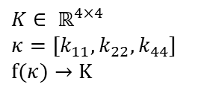
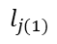
Meta Models
r= 54 mm
r= 42 mm
$$l_{j(1)}$$
$$l_{j(2)}$$
$K∈ ℝ^{4×4}$
$κ=[k_{11},k_{22},k_{44}]$
$f(κ)→K$
LPL I Sur, Kri, Zm, Zh

Slide 4
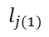
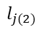
Short Comings
Connection structure – joint (with l_j)
Defining design and obstacle geometries within the meta models
Quick fix:
Solid material block
End Design idea: solution space intervals for attachment
Carrying out a detailed TopOpt with considering joint geometry and attachments explicitly
$$l_{j(1)}$$
$$l_{j(2)}$$

Slide 5
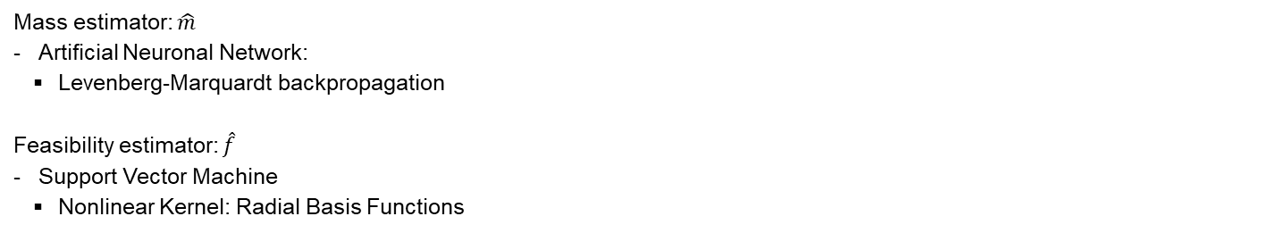
Sample Data
Mass_Samples: $X=[k_{11},k_{22},k_{33},l]∈ ℝ^{4×N}$, $y∈ ℝ^{1×N}$ → $[X;y]$
Classification_Samples: $X=[k_{11},k_{22},k_{33},l]∈ ℝ^{4×N}$, $y∈ ℝ^{1×N}$ → $[X;y]$
Meta Models
Mass estimator: $\hat{m}$
Artificial Neuronal Network:
Levenberg-Marquardt backpropagation
Feasibility estimator: $\hat{f}$
Support Vector Machine
Nonlinear Kernel: Radial Basis Functions

